Slide 1
The Art of Letting Go
Relationship Advice for Dev and Ops in the Cloud

Slide 2


Who is this guy?
Bryan Hopkins – University of Pennsylvania
Lead for Penn’s App Dev Cloud First team
Past Lives:
Cold Fusion developer (ewww)
Java developer
Architect on our frameworks team
Infrastructure team lead for our initial Banner implementation
Uses too much animation in presentations
Believes in keeping it simple
Notes:
So who is this guy standing in front of you to give DevOps relationship advice?
Hi, I’m Bryan Hopkins from the University of Pennsylvania. I’m the team lead for the application delivery side of our cloud team.
My first IT job was as a Coldfusion 4 developer at an e-commerce chop shop, and from there have worn hats as a Java developer, frameworks architect, and infrastructure team lead. So while Dev and Ops are very much separate at Penn traditionally, I’ve been on both sides.

Slide 3

What’s Penn up to?
“Yeah, they’ve got one of those ‘Cloud First Programs’” - Our AWS TAM
Homegrown frameworks Off the shelf frameworks
Complex waterfall projects Simplicity and Agility
Monoliths Integrations and composed apps
Homegrown platforms Built for the cloud
Something Tiffany hates Something Tiffany likes
Developers and Platforms teams “collaborate” through tickets Developers and Platforms teams play off each other’s strengths
Use less animations in slides. (See?)
Notes:
So why am I here? Like you, we’re trying to do things differently, and better.
Penn’s central IT group kicked off a Cloud First program this summer with the goal of doing all the standard good things.
Most importantly for us, that includes a culture shift away from custom platforms and development framework special snowflakes and reacquainting ourselves with modern architectures.
In doing so, part of what we hope to accomplish is for the developers and the platforms team to feel more like one big team who speak each other’s languages.
Rather than 2 different made-up languages … that you can’t even google translate badly.

Slide 4
Three things we’ve learned so far
Notes:
So, three pieces of advice from what we’ve learned so far…

Slide 5
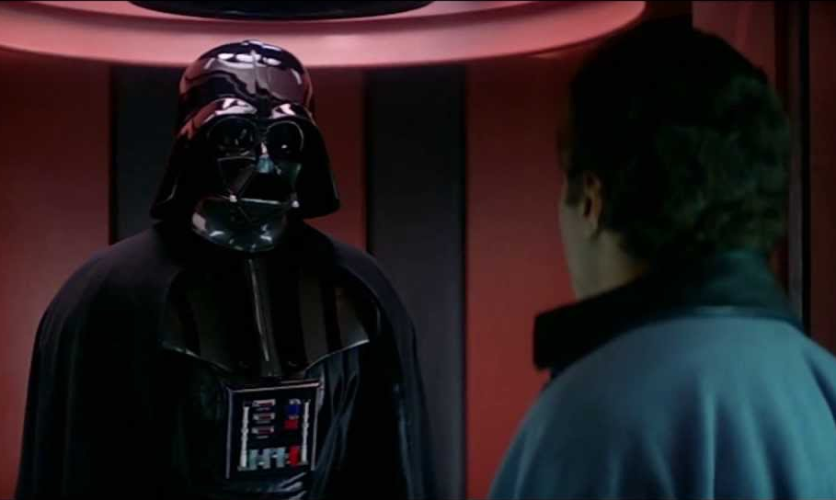
“I’m altering the deal, pray I don’t alter it any further”
Have a clear try-and-scrap phase
Both sides will give up on things
This can be frustrating otherwise
Encourage and make room for change
Some Penn examples:
BitBucket Gitlab
Bamboo Jenkins
OpenShift AWS ECS
OpenStack Cloud Formation
MongoDB PostgreSQL
Aurora
Cognito IAM Roles
This doesn’t mean any of these are bad, and won’t be revisited!
Notes:
Have a clear try-and-scrap phase.
We’ve changed directions on each other a number of times, and if we hadn’t been super up front about that from the get-go it would’ve been awful, especially if we’d been under pressure to deliver production systems without any experimentation or pilots.
From the dev side, we changed databases a few times, which makes your life as a DBA just wonderful.
We’re still feeling our way around the IAM tool space, and the platforms team changed our entire container load balancing strategy a few times.
But everyone was okay with it. On the dev side, we’ve gone from stressing about every detail and library on the application server to just worrying about code.
Where and how it runs is a question to just take a deep breath and let go of.

Slide 6

“Take evasive action!”
Accept that interests will collide
Development team can help with platform scripts
Platforms team can help with build and test automation
Everyone is invested in the CI pipeline
Bring together personalities that like to learn
Reward sharing and asking for help
Some Penn Examples
Jenkins!
Load balancing
IAM
Notes:
When you mash two words together to invent a new word like DevOps, you’re going to have interests collide.
If everything’s automated, you need some scripts. Who writes those?
If you want your build to go down different paths based on automated testing, who does what?
Jenkins and the CI pipeline is a huge conjunction of interests. Having flexible personalities that like to learn and collaborate makes that collision a strength rather than a crime scene.

Slide 7

“This may smell bad kid, but it’ll keep you warm”
Let go of notions of perfection and clean lines
No really. For everyone.
Off-the-shelf means you get what’s … on the shelf
If you can make it work, use it and iterate later… and give others the same leeway!
Some Penn examples
Who troubleshoots an authentication problem?
Who owns how application logging works?
When is it time to invest in automating a process?
Notes:
And most importantly, let go of notions of perfection.
We got ourselves into our custom special snowflake hole by trying to be perfect.
It’s been a tremendous boon give each other the benefit of the doubt that using something off the shelf buys us a lot of intangibles even if we have to hold our noses initially or step out of our comfort zones.
Our UI authentication is coming from a node module in the application code instead of our traditional apache plugin. We went several months without the ability to view application logs without help. These things were uncomfortable for everyone, but we made it work and its helped us trust each other.

Slide 8
Thank You!
And especially to Tiffany Hanulec (Platforms team lead) for helping with our nerdy metaphors!
Notes:
And with that, thank you! And a big thank you to Tiffany Hanulec, my platforms team counterpart. Just like our cloud first program, everything in this presentation was a joint effort in dorkiness.

